Slide 1
Where Are We Meeting?
Ahmad Askar, Nikhil Milind, Nikhil Reddy, Sreeram Venkat

Slide 2


What’s the Problem?
Schedule Global Conferences while maximizing the productivity of participants

Slide 3
Scenarios
Scenario 1
Monterey CA, USA
Zutphen, Netherlands
Melbourne, Australia
Shanghai, China
Hong Kong (SAR), China
Moscow, Russia
Scenario 2
Boston MA, USA (X2)
Singapore
Beijing, China
Hong Kong (SAR), China (X2)
Moscow, Russia
Utrecht, Netherlands,
Warsaw, Poland
Copenhagen, Denmark
Melbourne, Australia

Slide 4
Our Plan of Action for the Model
Calculate the amount of jet lag a participant experiences travelling to the destination of the event
Quantify the effects that jet lag has on productivity for each participant
Find the airfare and lodging cost associated with the travel
Considering the above factors, determine the optimal location to hold the event
Notes:
\item Calculate the amount of jet lag a participant experiences travelling to the destination of the event.\itemnewline
\item Quantify the effects that jet lag has on productivity for each participant.\itemnewline
\item Find the airfare and lodging cost associated with the travel.\itemnewline
\item Considering the above factors, determine the optimal location to hold the event.

Slide 5
General Assumptions
Seasonal variations in productivity and seasonal changes to airfares are difficult to quantify
Conference members will be most productive in a climate that mirrors their climate of origin
Business travelers do not prepare to correct jet lag and follow their internal circadian clock until arrival
Participants only work when they are together, i.e. there is no individual work involved
There are flights available to fly to any given location at the times we specify

Slide 6

Circadian Rhythm
A cyclic biological process
Responsible for daily processes without external day-night cues
Average period for humans is 24.5 hours

Slide 7

External / Internal Clock
External clock is the time at the given location
Internal clock is what our body believes, or feels like, the time is

Slide 8

Jet Lag
When internal and external clocks disagree
Internal clock = initial time zone (Z_{i})
External clock = final time zone (Z_{f})

Slide 9

Productivity
A measure of restfulness of the participant
Value decreases as jet lag increases

Slide 10
Calculating Jet Lag

Slide 11
Specific Assumptions
Business hours occur between 8:00 AM and 6:00 PM in the location’s timezone.
Buildings are closed between midnight and 8:00 AM.
We assume that the circadian rhythms of all participants are oscillatory with an average period of 24.5 hours.

Slide 12
Specific Definitions
Productive Hours: The hours between 8AM and 6PM in which the participants are able to do intensive work
S: The amount of productive hours lost due to jet lag

Slide 13

Quantifying the Loss of Productive Hours
The loss of productive hours S is defined in terms of the time zone difference ΔJ.
Increasing ΔJ from 1 to 2 should cause a significant change in the value of S, whereas increasing ΔJ from 11 to 12 should have little to no effect.
A sinusoidal graph creates this convexity and concavity.

Slide 14
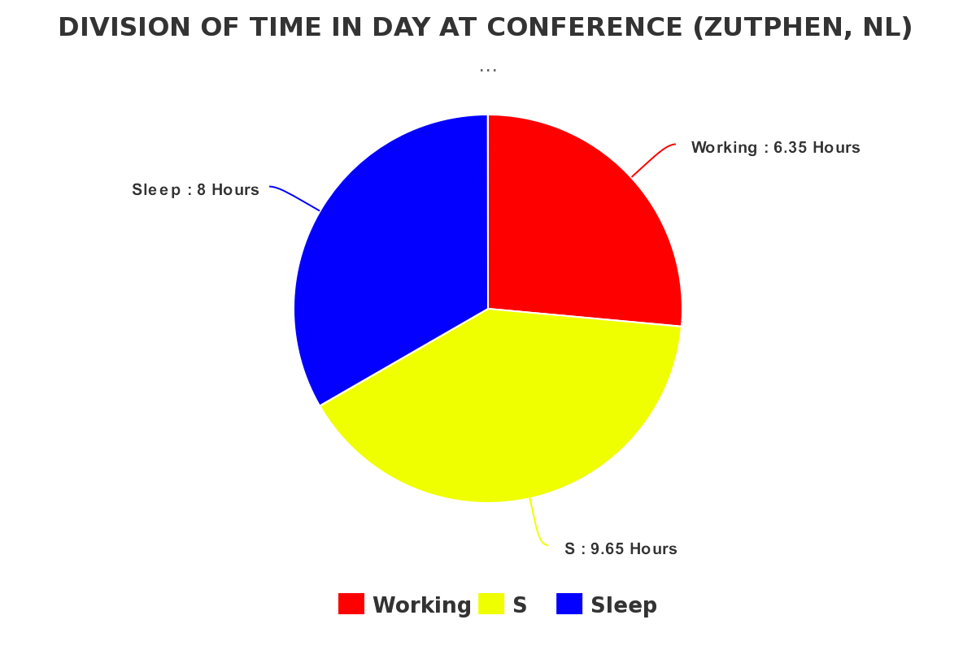



Implications on Productivity

Slide 15
Maximizing Productivity κ

Slide 16
Specific Assumptions
Productivity is solely a function of distance traveled and jet lag
We assume that the amount of jet lag decreases by one hour with every one night of 8-hour sleep time

Slide 17

Flight-Related Fatigue
Losses in productivity can also occur from fatigue after a lengthy flight
The worst case scenario for a flight is traveling 12450 miles, half the circumference of the Earth.

Slide 18

The Final Metric

Slide 19
Finding Cost

Slide 20
Specific Assumptions
The average fare for a ticket, given a distance d, can be calculated as 50+0.11d dollars. Furthermore, we assume that miscellaneous costs such as food will be the same at all locations, so we do not consider them in our calculations.
We estimate the cost of lodging in any given country by using the average lodging expense of a 4-star hotel, which is $150.
The participants will leave at the end of the final day of the conference.

Slide 21


Model Design of Cost
The total cost M of the meeting is the sum of the total ticket costs C and the lodging costs L.
In particular, since the meeting is 3 days long, L is 450 dollars per person.

Slide 22
Model Implementation and Algorithm

Slide 23
Center of the World
Our model gives an ideal meeting place when the locations of the participants are known.
Some global conferences do not have the luxury to know the locations of participants
In addition, it is useful for the IMMC to have one central headquarters instead of scheduling all across the world.
Given a location, the probability of a participant to be from that location is proportional to the location’s GDP.

Slide 24
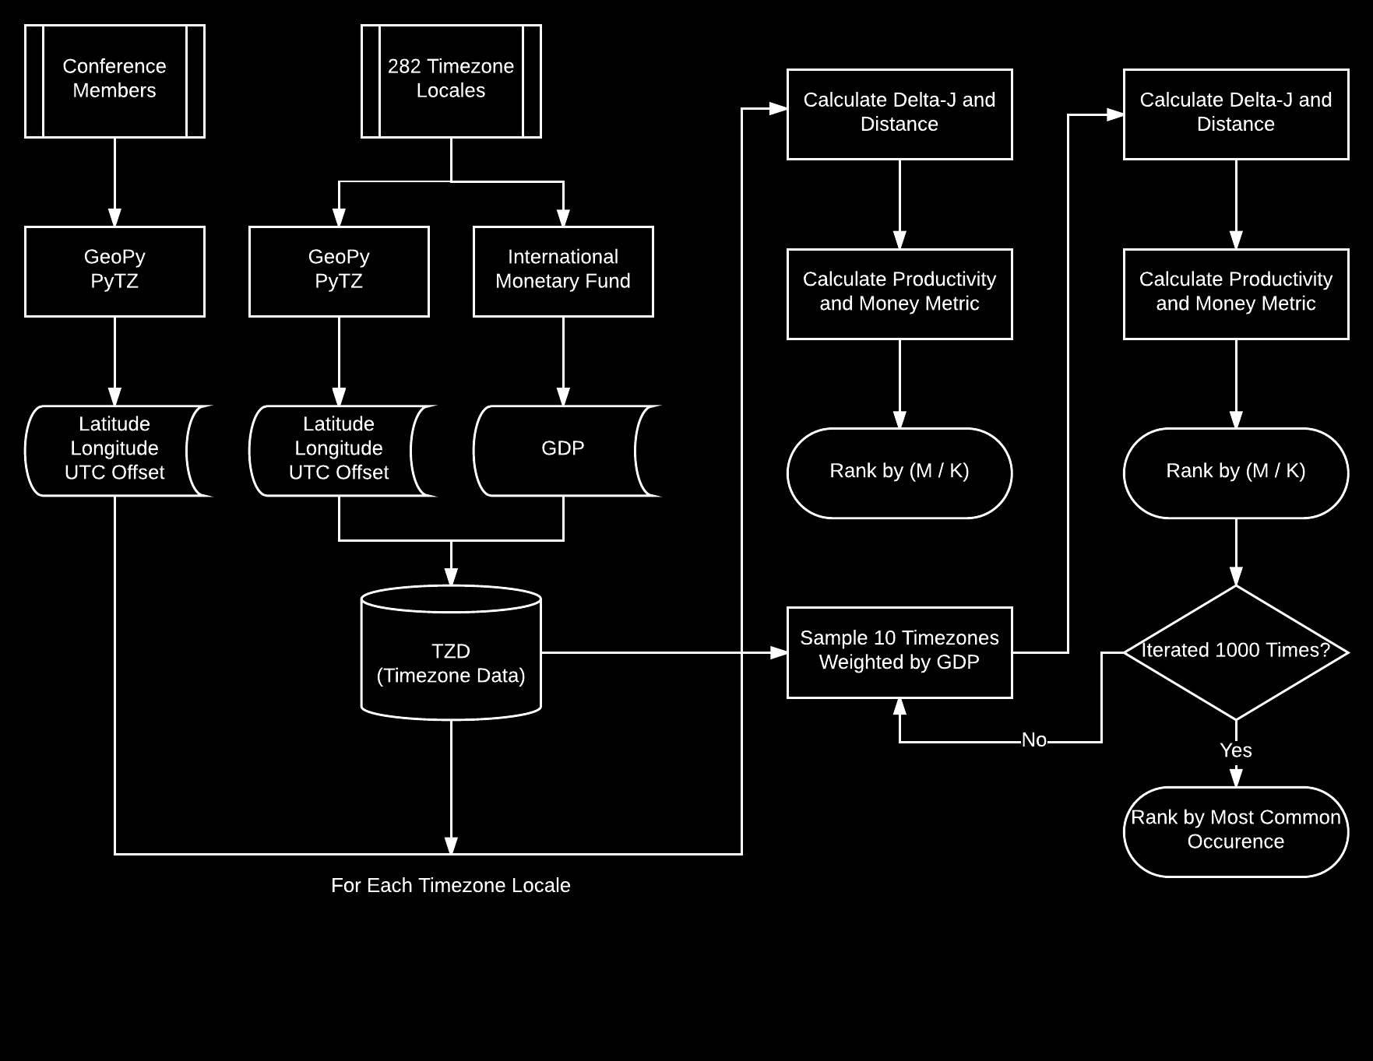

Slide 25
Results

Slide 26
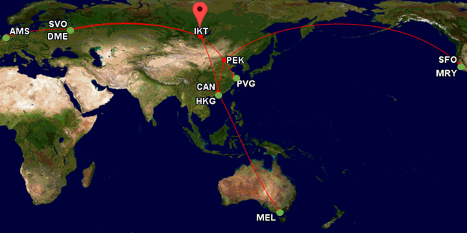
Small Conference - Irkutsk, Russia

Slide 27
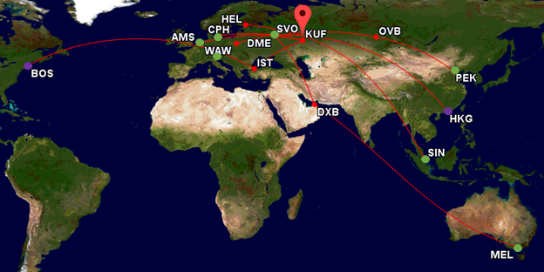
Large Conference - Samara, Russia

Slide 28
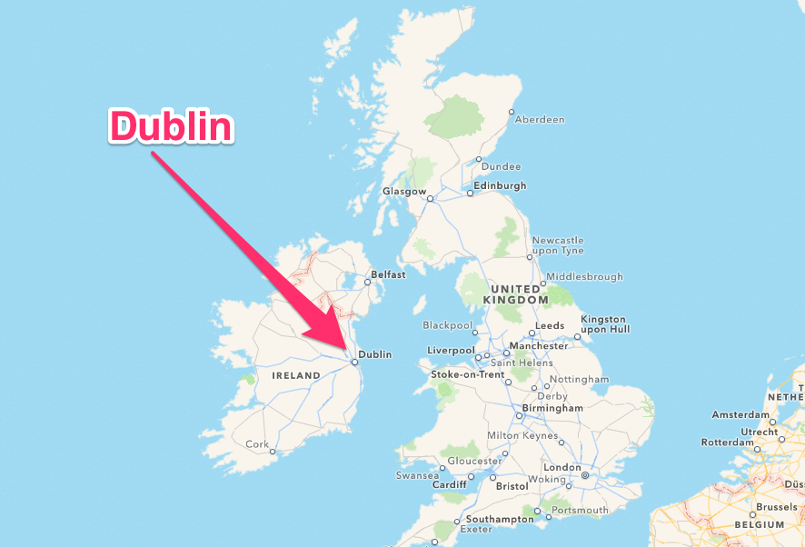
Center of the World - Dublin, Ireland

Slide 29
Sensitivity Analysis

Slide 30
Sensitivity Analysis
The model is robust to :
Removing outliers
Changes to airfare
Variations in working hours
The model is affected by
Extreme outliers

Slide 31
Strengths and Weaknesses

Slide 32
Strengths
Our model is robust against changes to the parameters involved in calculating the metrics
Our model considers both jet lag and distance traveled in our metric, allowing it to be an accurate measure of productivity
Our model uses a comprehensive list of timezone and analyzed the metric values for each cities in a manner that is able to reproduce very precise values for all 282 cities
Our model is versatile and can calculate the optimal meeting location given any set of attendees. This versatility allowed us to calculate the “Center of the World”
Our model takes into account Daylight Savings Time (DST) at each timezone, allowing for more accurate jet lag calculations
Our model uses the Vincenty distance formula, treating the Earth like an ellipse and allowing for more accurate distance calculations.
Our algorithm is not computationally intensive and can be calculated for large data sets in a relatively short time.

Slide 33
Weaknesses
Our model does not consider variations in the prices of lodging between different locations due to the unavailability of lodging price data.
Our model does not consider the availability of flights between locations.
Our model does not consider losses in productivity caused by the lower availability of high-equality working areas in rural regions for the world.
Our model does not consider the loss in productivity that an individual experiences after he/she leaves the meeting location.
Our model does not consider the effects of climate on productivity.

Slide 34
Images Cited
http://www.enn.com/image_for_articles/45061-1.jpg/medium
http://www.willoch.no/wordpress/wp-content/uploads/2012/04/Productive.jpg
http://www.prevention.com/sites/prevention.com/files/styles/article_main_image_2200px/public/shutterstock_360063584-circadian-yomogi1-opener.jpg?itok=eTdpBVwV
http://ehonami.blob.core.windows.net/media/2014/05/harmonize-your-internal-clock-to-retune-your-health.jpg
https://i.kinja-img.com/gawker-media/image/upload/s--YYh2hz6h--/c_scale,f_auto,fl_progressive,q_80,w_800/1444999494280623501.gif
http://dishwashersguide.com/wp-content/uploads/2016/02/saving-time-with-modern-appliances.jpg
http://www.travelthruhistory.tv/ThruHistory/wp-content/uploads/2014/11/dublin.png

Slide 35
Questions?

Slide 36
Acknowledgements
Dr. Daniel Teague
James B. Hunt Library
GeoPY and PyTZ Development Teams
COMAP and IMMC

